Slide 1
LICENSE PLATE RECOGNITION SYSTEM
MINI PROJECT 2022-23
AKSHANSH MISHRA 2102901520011
ARYAN VASHISTH 2102901520032
DEVANSH DEEPAK 2102901520044

Slide 2
INTRODUCTION
License Plate Recognition (or 'number plate recognition') is a special form of optical character recognition (OCR).
It enables computer systems to read automatically the registration number (license number) of vehicles from digital pictures.
Reading automatically the registration number means transforming the pixels of the digital image into the ASCII text of the number plate.
OCR technology scans paper documents and turn them into electronic, editable files.

Slide 3
BASIC OCR
IMAGE INPUT
INUT GIVEN IN DIGITAL FORMAT
FEATURE EXTRACTION
DETAILS THAT NEED TO BE RECOGNIZED
INTEGRATED TO AN OUTPUT PLATFORM
THE EXTRACTED OUTPUT WILL BE RETURNED TO USER

Slide 4
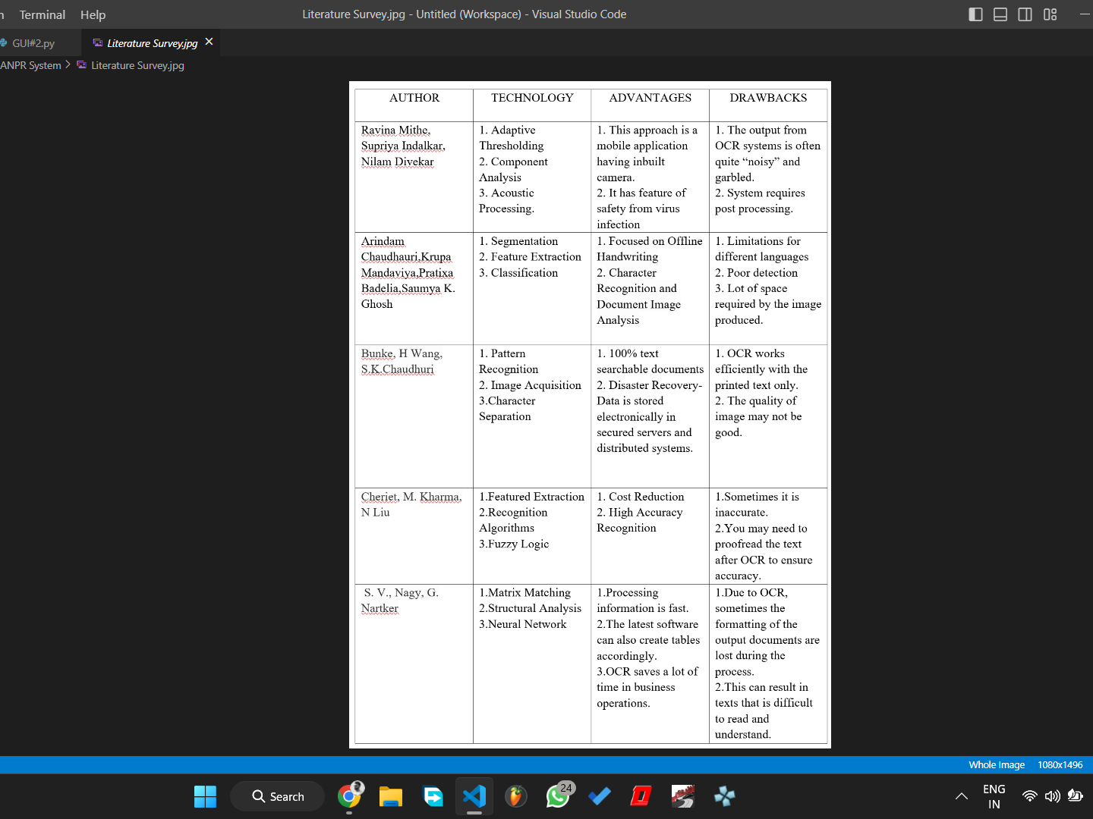

Slide 5
PROBLEM STATEMENT
Automated License Plate Recognition System is the identification system of vehicles. It is an image processing technology used to identify the vehicles only by their license plates.
Automatic Number Plate Recognition ANPR plays a major role in management of parking areas, and surveillance in variety of sectors.
Since every vehicle has a unique number plate so it can be identified by its number plate. Thereby a system with high flexibility and better accuracy with increased use cases and simpler algorithms will become handy in accomplishing such tasks and ease up Human work force.

Slide 6
HOW TO BULIT ANPR SYSTEMS ?
SOFTWARE -
Python Libraries and Framework used-
Classifier: haarcascade : ML based for code simplification.
OpenCV : for this project in order to identify the license number plates In digital image
Pytesseract : for the characters and digits extraction from the plate.
FRONTEND -
Tkinter, flutter
HARDWARE -
A good FPS image capturing device.

Slide 7
BASIC CONCEPT OF LPRS
DETECTION
CONVERSION
RECOGNITION

Slide 8
DETECTION
-we have used a classifier - haarcascade
haarcascade is a ML based model which is trained on tons of dataset and hence can detect objects from an image. In our case, it will detect number plate from the input image.
-you can use YOLO as well, but we have used Haarcascade for simplification of code.

Slide 9
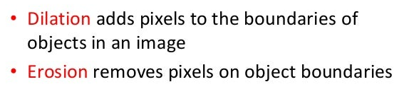
CONVERSION
image reading = cv2
Open CV computer vision library
/Most powerful
/contains 1000s of algorithms for identification
/Built in C, C++
we have used techniques like gray conversion for converting the input image into grayscale and then performing required operations.
#Cropping number plate ->changing brightness and threshold/sharpening
-using dilate and erode of cv2 then converting again to b/w
-applying threshold

Slide 10
RECOGNITION
-you can use Deep Learning, CNN etc
-we are using pre-trained OCR engine built by open source contributors
PYTESSERACT
-using "image_to_string " to convert all content into text
- use string processing to eliminate the extra characters

Slide 11
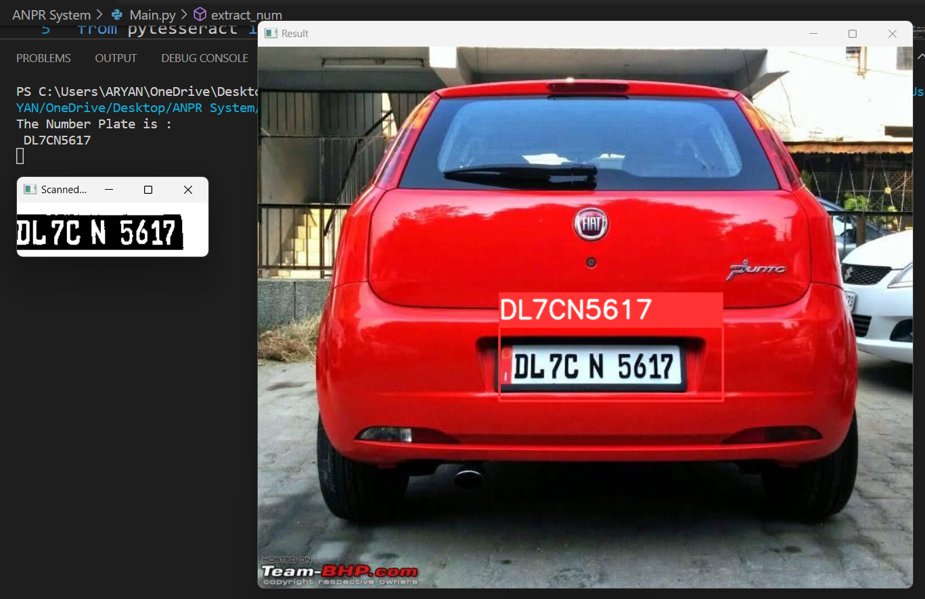

Slide 12
APPLICATIONS:
Intelligent Transportation Systems (ITS),
security systems
motorway toll collection (highway toll collection),
traffic analysis,
police law enforcement,
state border control,
enforcement of traffic regulations,
vehicle theft prevention,
automation and simplification of airport,
harbor and warehouse logistics,
security monitoring of roads and checkpoints
vehicle surveillance

Slide 13
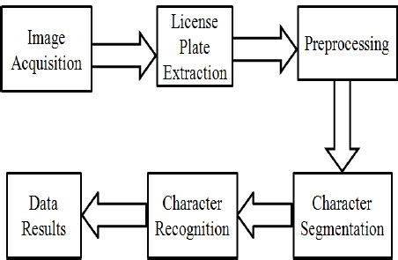
INNOVATION
The idea of OCR is basic, but its actual potential is yet to be discovered. Contributing to the same, we will try to implement it on real-time applications:
- Multiple Inputs
- Image/Video Capture
- As a utility for software
- Management & Surveillance

Slide 14
REFERENCES
www.anpr.net
en.wikipedia.org
https://www.javatpoint.com

Slide 15
THANK YOU

